Slide 1
HUB Program
Notes:
Introductions to anyone with procurement services – name and title.

Slide 2
HUBs
HUB stands for Historically Underutilized Business.
To become a HUB, a business must be:
A Small Business
At least 51% owned by a(n):
American Woman
Asian Pacific American
Black American
Hispanic American
Native American
Service-Disabled Veteran
Based in Texas
A business that meets these criteria can apply for HUB certification
Notes:
What are HUBs?

Slide 3
HUBs
Historically Underutilized Businesses
Contract Category | % Spent with HUBs
Heavy Construction (other than building contracts) | 11.2%
All Building Construction | 21.1%
All Special Trade Construction | 32.9%
Professional Services | 23.7%
All Other Services | 26%
Commodities | 21.1%
By law, every state agency and university must aim to meet these HUB Goals.

Slide 4
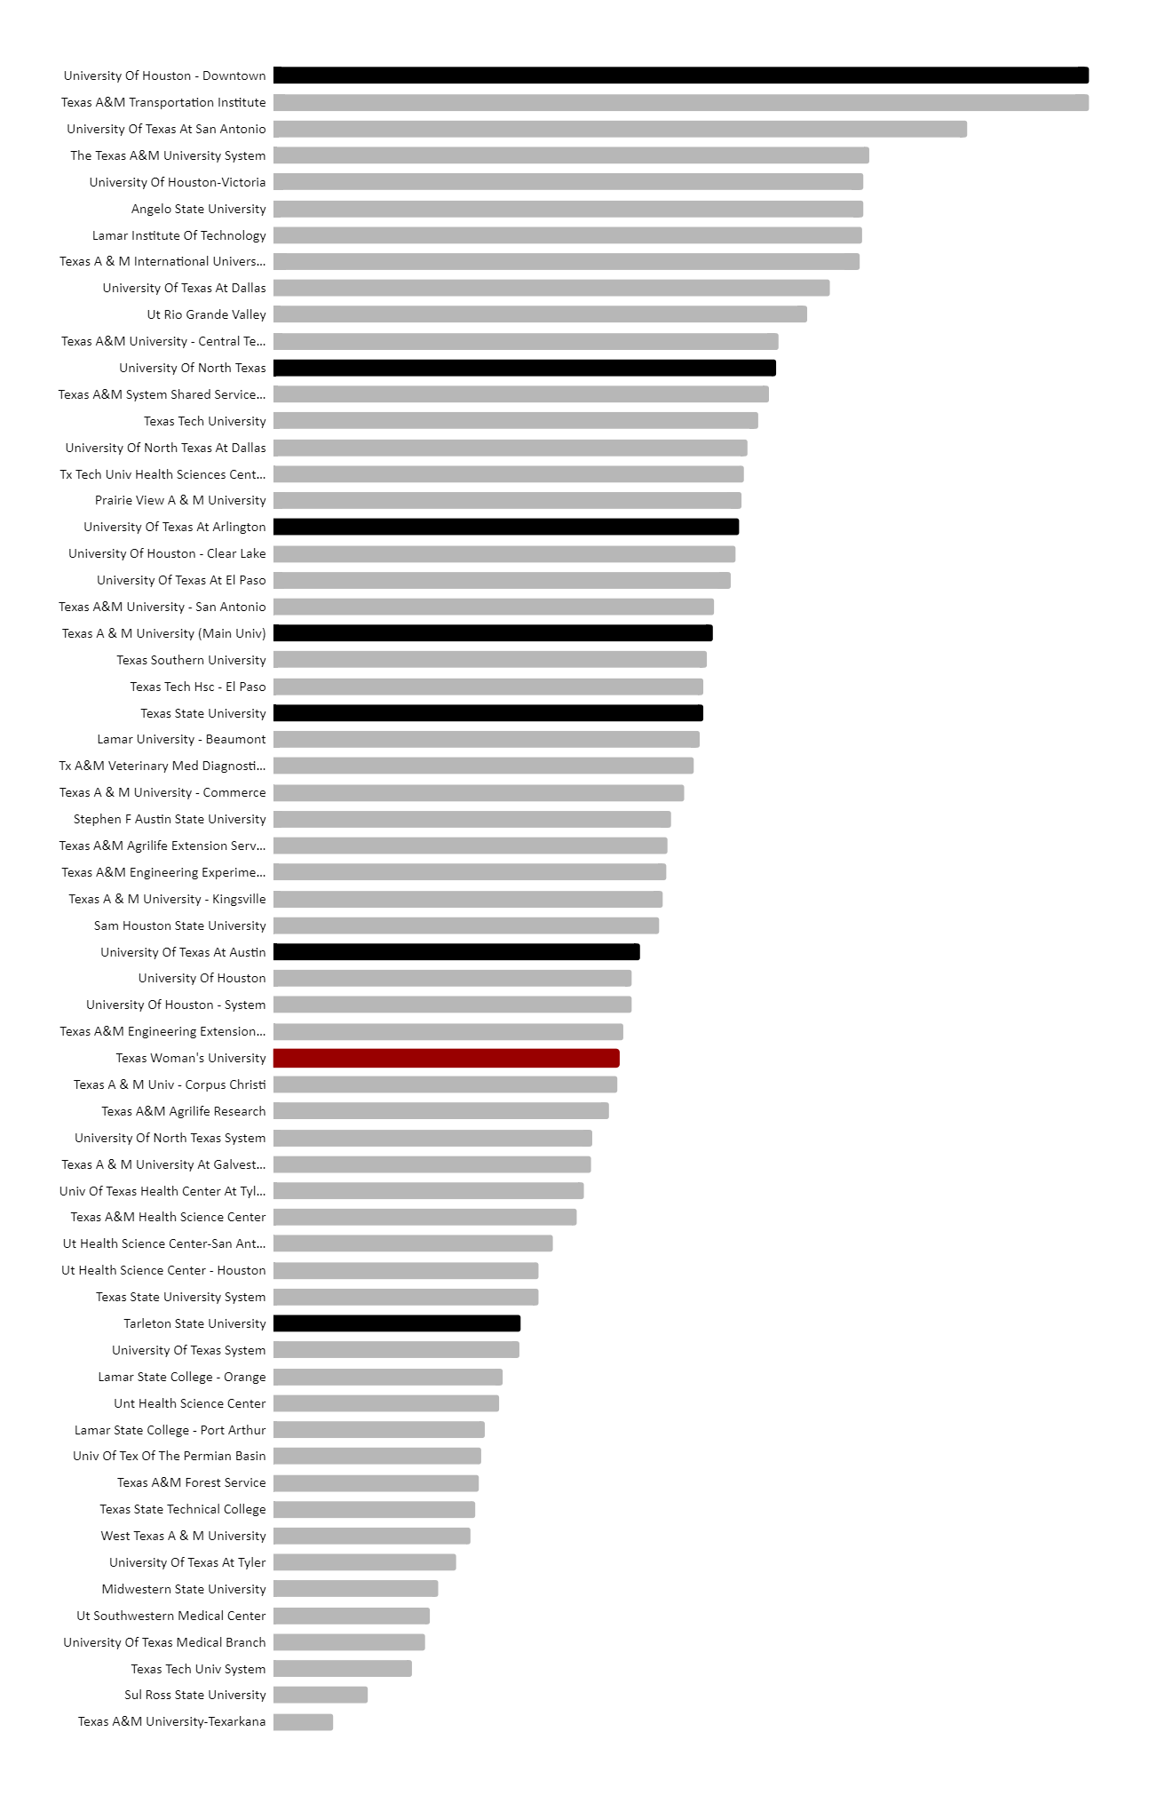
HUBs
Historically Underutilized Businesses
So, how do we stack up?
In 2023 TWU ranked at #38 out of 63 Texas Universities for % expenditures with HUBs.
How can we do better this year?
#1
UHD
#12
UNT
#18
UTA
#22
TAMU
#25
TXST
#34
UT
#38
TWU
#48
Tarleton

Slide 5
HUBs
Historically Underutilized Businesses
This is the BIGGEST HUB event in Texas, and our best shot at finding amazing HUB vendors.
The
Spot Bid
Fair!
We need your bids by May 1st!
Not sure what to bid for? Here are some actual bids from previous years:
1 dry erase marker
$1.41
6 rolls medical tape
$60.90
8ft fiber-glass ladder
$207.00
32 custom women’s polo shirts
$1,065.28
HVAC cooling tower maintenance
$100,000.00

Slide 6
Contact Information
Shawna Smyth, HUB Associate
ssmyth@twu.edu
898-2541
Notes:
Check out our procurement training calendar on website – for future trainings in contracts, purchasing and pcard

