Slide 1
Office of Financial Aid

Slide 2
TWU Financial Aid Office
Administration Conference Tower, Room 201
    Monday – Friday, 8:00 a.m. to 5:00 p.m.
Contact us
    Phone: (940) 898-3064
    Fax: (940) 898-3068
    Email: finAid@twu.edu
Online Information - www.twu.edu/finaid/
Financial Aid Advisors at each TWU campus

Slide 3
How Can I Receive Financial Aid to Pay My Bill?
Complete the following forms by the published deadlines.
  Free Application for Federal Student Aid (FAFSA)
    Complete the 2023-2024 FAFSA using 2021 taxes
    Use TWU School Code = 003646
    Use IRS Data Retrieval Process
Submit other forms as requested by the Financial Aid Office.

Slide 4
Types of Financial Aid
Go to https://twu.edu/finaid/types-of-aid/ and select a category:
  Scholarships
  Grants
  Loans
  Student Employment/Federal Work Study
Within each category you will find information about available awards, eligibility requirements for each, and most aid as awarded requires fulltime enrollment.
Be sure to review the “Meet and Maintain Eligibility Requirements” section for information regarding what is needed and what must be maintained to continue qualifying for federal aid and state awards. Remember – you will only receive aid for classes that apply to your current degree plan.
Notes:
By submitting a FAFSA the student applies for federal aid, including federal grants, and state grants. In addition to Federal Grants TWU also awards federal Direct Loans and federal work study. For more information please see our website to review the eligibility requirements for financial aid. Students must be degree seeking, no pursuing a certificate only, have enrolled in degree applicable coursework, be making satisfactory academic progress, and have a completed financial aid file.

Slide 5
What happens after I am awarded financial aid?
After all required documents are submitted an email will be sent to your TWU email account notifying you that you have a financial aid award.
Follow the instructions to view and accept or reject your awards through your TWU Self Service.
After you have taken action on offered awards, you are required to review and acknowledge your award letter in Self-Service.
Please note that if awards are left in pending status you will not have access to acknowledge your award letter which is required to receive a financial aid disbursement of accepted financial aid, including grants.
Notes:
Once your initial check list has been completed two more steps will be added. Accept or Reject Financial Aid Awards, and Acknowledge Award letter. When taking action on awards no awards can be left in pending status, or the student will not have access to acknowledge the award letter.

Slide 6
What steps do I take if I accept a federal loan?
Electronically sign the Master Promissory Note (MPN) and Complete Entrance Loan Counseling at https://studentaid.gov
If the student needs additional loans, a parent may apply for the Federal Direct Parent Loan:
  Complete the PLUS Loan Application and Master Promissory Note at https://studentaid.gov by selecting APPLY FOR AID.
  Graduate students will also apply for the Graduate PLUS loan at https://studentaid.gov
Loan funds cannot be released at the appropriate time unless both the Loan Agreement and the Entrance Counseling have been completed.
Notes:
What do you need to do if you are awarded loans?
If you have accepted federal loans on your TWU Self Service you will need to complete additional steps to finalize your loan awards.
If you are awarded a Federal Direct Subsidized or Unsubsidized Stafford Loan or a Grad Plus loan, you will need to go to www.studentloans.gov to
complete the loan process including completing Entrance Loan Counseling and electronically signing the Master Loan Agreement.
If your parent wishes to apply for a Federal Parent Loans for Undergraduate Students (PLUS), your parent must go to the www.studentloans.gov website to apply. Please note, parents of Graduate Students are not allowed to borrow a Federal PLUS, or a Graduate PLUS.

Slide 7
Financial Aid Reminders
Your Accepted aid will show as a payment made on your bill
Your Aid will not disburse to your bill until classes begin
You must take action on all aid in order to electronically acknowledge your Award Letter in your Self Service
Only classes that are required on your degree plan will count as eligible courses for financial aid
Must complete required Entrance Counseling and MPN for Direct loans

Slide 8
Zero Tuition Guarantee
The Zero Tuition Guarantee helps eligible students pay the gap between regular tuition and mandatory fees and what is paid through the Federal Pell Grant program.
Tuition & Fees are paid with a combination of Need-based awards and will be reviewed and adjusted after census date
To Qualify:
Be a Texas Resident
Submit a FAFSA or TASFA
Demonstrate Financial Need
Must be Pell Eligible
Enroll full-time as first time in college OR new transfer student pursuing first BA degree
Maintain Satisfactory Academic Progress for renewal
Twu.edu/zero/

Slide 9
Family Educational Rights and Privacy Act
The Family Education Rights and Privacy Act of 1974 (FERPA), protects personally identifiable information in student education records such as the student’s financial aid record, billing information, and grades from disclosure without the student’s signed, written consent.
Students may authorize person specific access to their education records by completing an “Authorization to Release Education Records” form and returning to the Registrar’s Office. This form can be found at:
www.twu.edu/media/documents/registrar/FERPA-release.pdf
Notes:
Once your student has attended their first class their academic and financial records are at that point protected by the Family Education Rights and Privacy Act. In order for our staff to speak with a parent about the student’s record, the student must have given prior written authorization to the university. Students may complete and submit the Authorization to Release Education Records form to the University Registrar. Please note the form requires the student to set a password, and the parent must be prepared to provide the password to staff, before being allowed access to information in the students financial aid file.

Slide 10
TWU Financial Aid Office
Administration Conference Tower, Room 201
    Monday – Friday, 8:00 a.m. to 5:00 p.m.
Contact us
    Phone: (940) 898-3064
    Fax: (940) 898-3068
    Email: finAid@twu.edu
Online Information - www.twu.edu/finaid/
Financial Aid Advisors at each TWU campus.
Notes:
Thank you for attending our virtual presentation. We look forward to seeing you smiling faces on campus!

Slide 11
Glen Ray
Director of Student Accounts & Bursar

Slide 12

Office of the Bursar
Admissions/Registration Building
304 Administration Drive
Denton TX 76204
Phone: 940-898-3570
Fax: 940-898-3578
Email: payments@twu.edu
Window Hours: M-Thur, 9am – 4pm
Phone Hours: M-F, 8am – 5pm
www.twu.edu/bursar

Slide 13




What are Accepted Payment Methods?
Credit/Debit Cards Online Only - 2.95% addt’l fee
  MasterCard/VISA
  American Express
  Discover
Personal Check (unless past-due balance)
Cash
Money Order/Cashier’s Check
WebCheck (ACH)
Financial Aid Awards

Slide 14
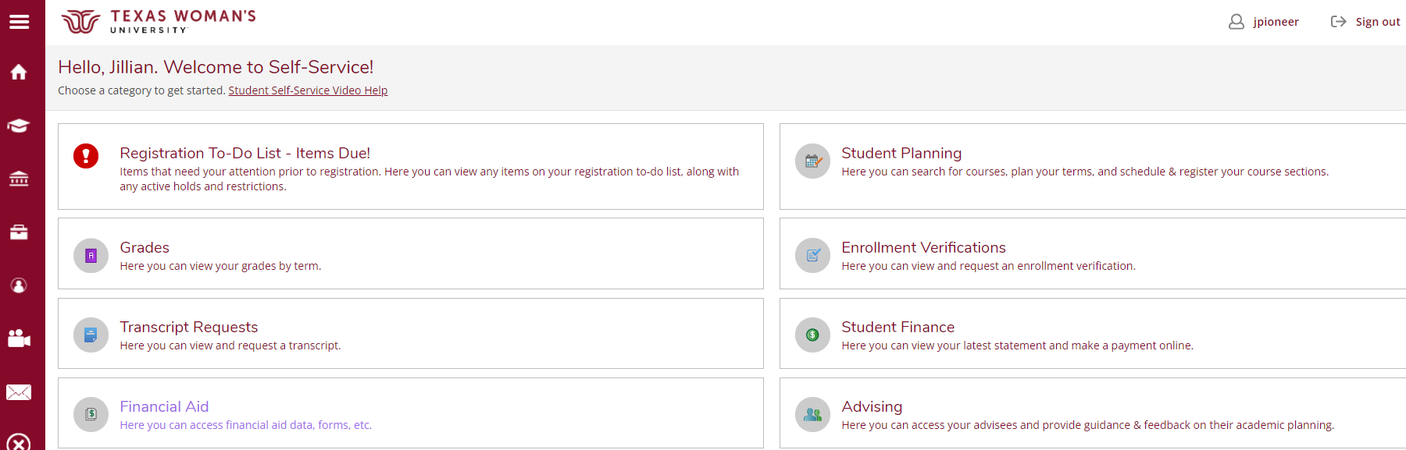
Where’s My Bill?
Bills are not mailed>>access in Self-Service

Slide 15
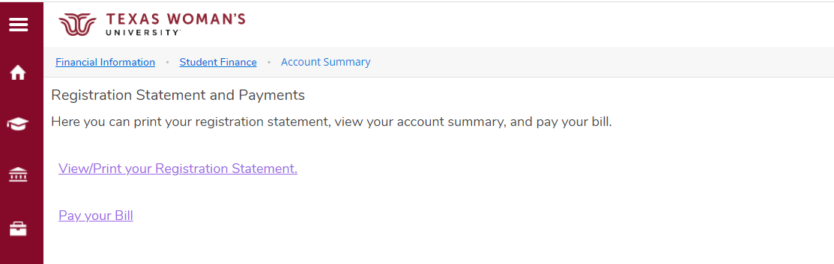
View Detailed Bill with Class Schedule

Slide 16
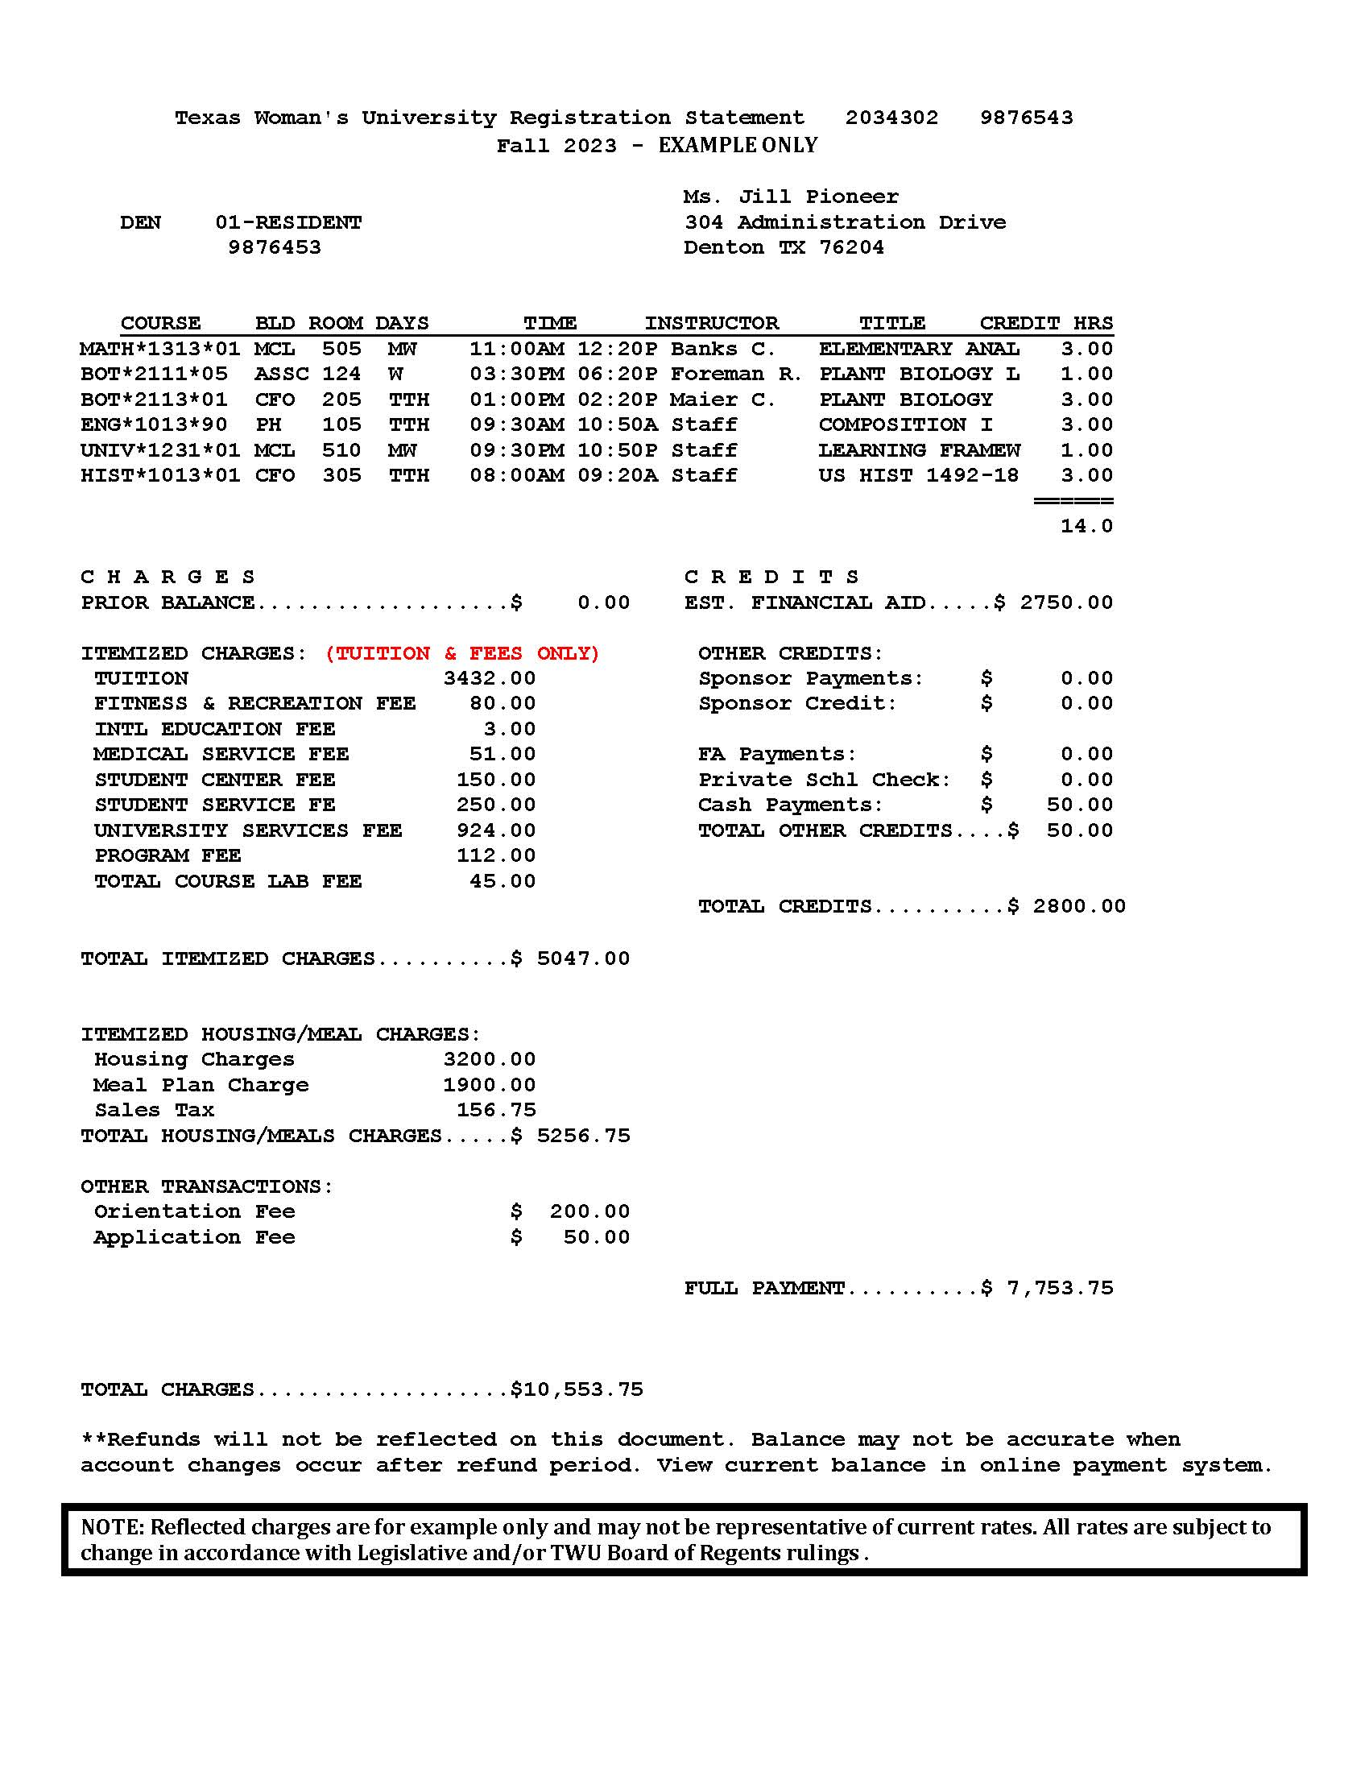

Slide 17
Student ID
Total hours

Slide 18
Due January 12

Slide 19
What are my Payment Options?
Payment in Full
  Full payment must be received by posted payment deadline.
Installment Payment Plans
  Regular semester plan - 4 payments
  Emergency plan – 3 payments

Slide 20
Spring 2024 Installment Plan
25% down payment required of remaining balance
$25 installment fee included
Accepted financial aid applied first
Three monthly payments:
  Feb. 15 Mar. 15 Apr. 15

Slide 21
Spring 2024 Emergency Plan
Designed for students awaiting financial aid processing
No down payment upon enrolling
$25 installment fee added
Balance in three monthly payments:
  Feb. 15 Mar. 15 Apr. 15

Slide 22
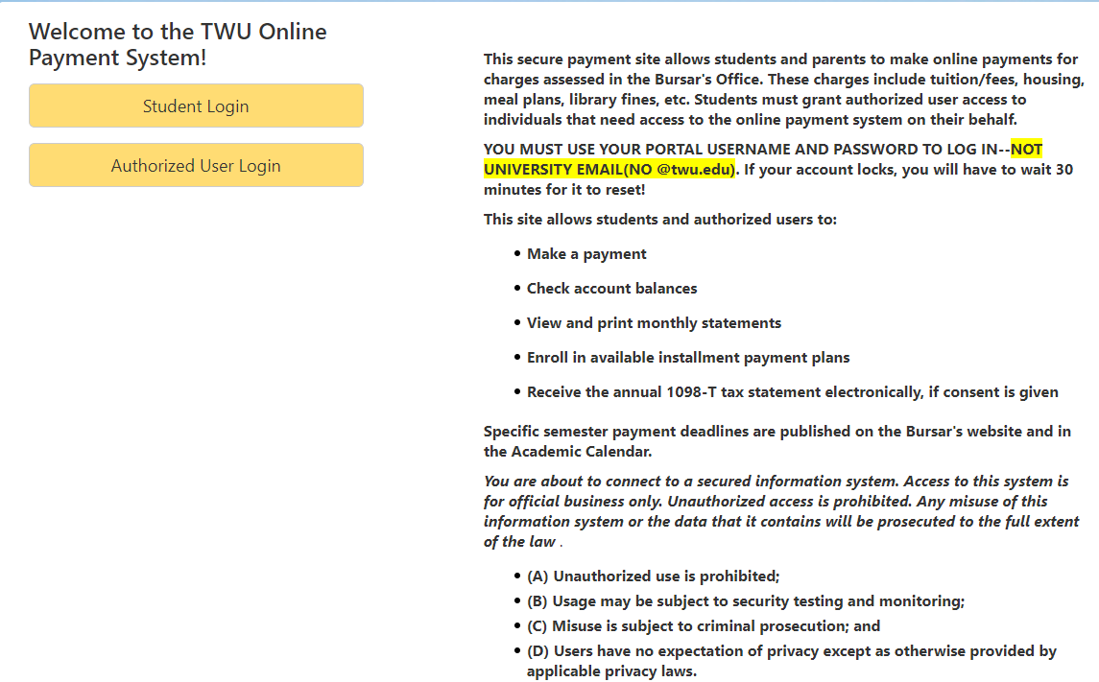
Pay for Classes/Pay My Bill>Payment Plans

Slide 23
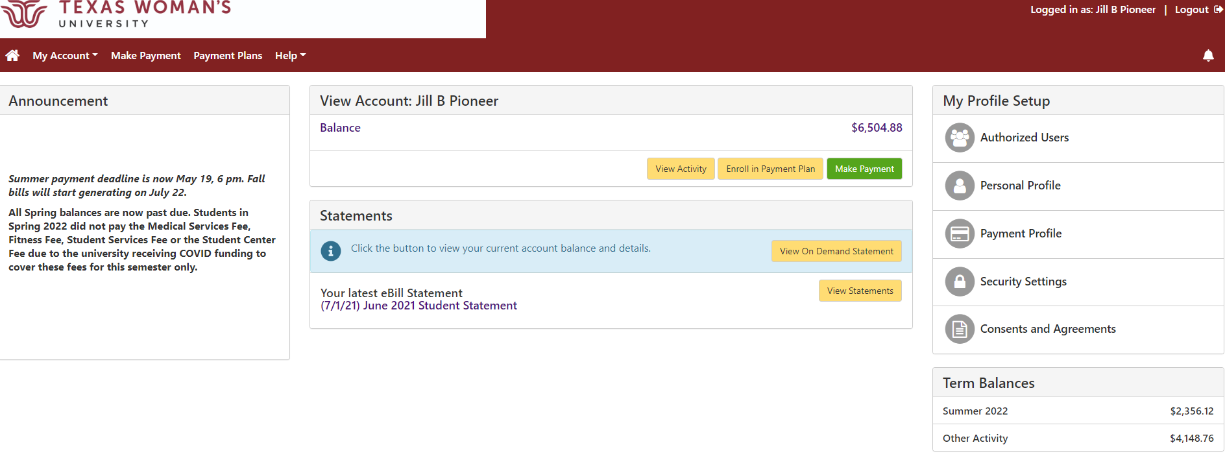

Slide 24
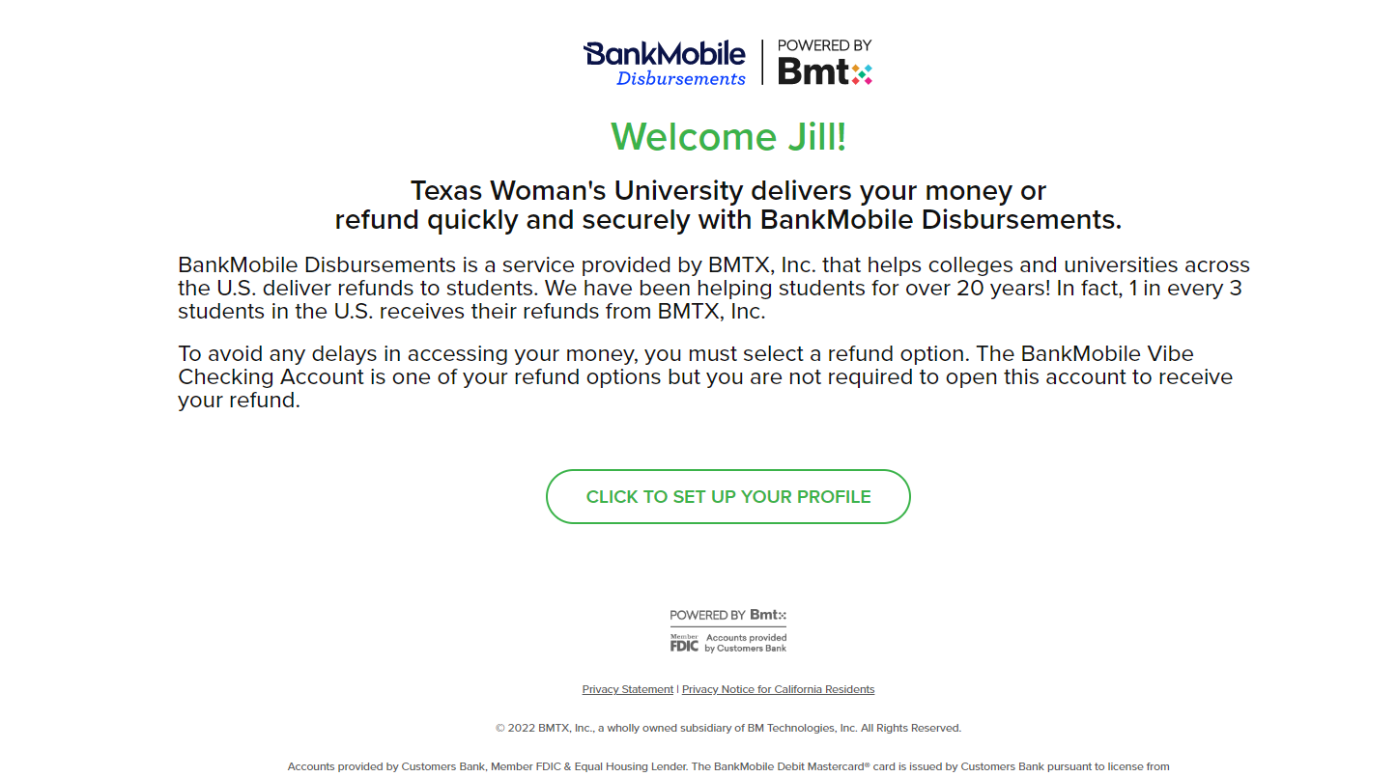
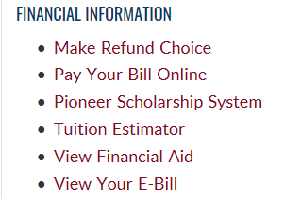
How do I get my refund? > In Portal select Make Refund Choice

Slide 25
Fixed vs Standard Tuition
Credit Hour Rates
Students entering 2023-24 | Year 1 | Year 2 | Year 3 | Year 4
Fixed Plan | $288.88 | $288.88 | $288.88 | $288.88
Standard Plan | $238.00 | TBD | TBD | TBD
Students entering 2022-23
Fixed Plan | $267.41 | $267.41 | $267.41 | $267.41
Standard Plan | $234.00 | $238.00 | TBD | TBD
Students entering 2021-22
Fixed Plan | $267.41 | $267.41 | $267.41 | $267.41
Standard Plan | $234.00 | $234.00 | $238.00 | TBD
Students entering 2020-21
Fixed Plan | $251.93 | $251.93 | $251.93 | $251.93
Standard Plan | $230.70 | $234.00 | $234.00 | $238.00

Slide 26
WELCOME TO TWU!
Remember Fall Payment Deadline
is January 12th

Slide 27
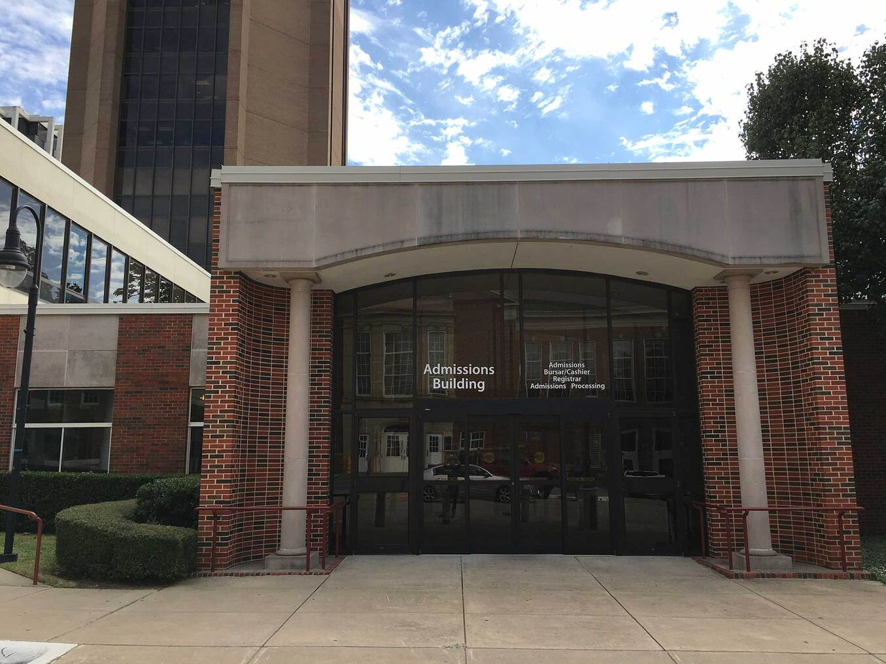


Student Money Management Center
Admissions Building, Room 123
(940) 898-2274 (CASH)
smmc@twu.edu
www.twu.edu/smmc
@TWUMaroonMoney

Slide 28
Our Team
Maroon Money Mentors
TWU students trained as peer educators, Certified Financial Peer Mentors
Have a passion for helping others
Facilitate goal-setting, action plans, and accountability to help the student move toward healthy financial decisions
Enjoy creating programs and social media content, and
engaging with students, parents, faculty, and staff

Slide 29

Through the center, students can:
Schedule a peer-to-peer financial coaching session
www.twu.edu/smmc
Learn money management skills to help with:
Earning
Saving and Investing
Protecting
Spending
Borrowing
Paying for your Education

Slide 30

Student Money Management Center
We want to be part of your solution to
financial and academic success!

